Slide 1
POLICY MANAGEMENT SYSTEM
GROUP CODE: 4
INTERNAL GUIDE : Mr. Dhwanir Shah
EXTERNAL GUIDE: Mr. Prashant Malvaiya
GROUP MEMBERS :
Contractor Mohammed H (3016)
Saiyed Rumaila R (3074)
Shah Zeel B (3060)

Slide 2
POLICY MANAGEMENT SYSTEM
Policy Management System includes a Web Portal for the Agent/Admin so that he/she can manage his/her client .
It also includes an Android application that will help the client/user to get information without calling the agent .

Slide 3

COMPANY PROFILE
COMPANY NAME: EXPERT WEB-DESIGNING
ADDRESS : 1st Floor , 124 Platinum Plaza , Opp. Kunj Mall , Nikol-Naroda Road,Ahmedabad,382 350.
CONTACT NUMBER : (+91) 8000436640.
CONTACT PERSON : Prashant Malvaiya.
EMAIL ID : info@expertwebdesigning.com
WEBSITE : www.expertwebdesigning.com

Slide 4
EXPERT WEB-DESIGNING is an Indian IT Company for Software Development ,Website Development, Web Hosting, Web Designing, Search Engine Optimization, Mobile Solutions and lot many IT and IT Enabled Services.
EXPERT WEB-DESIGNING is a Software Product based company who develops different software products and sell into Market. EXPERT WEB-DESIGNING is in Website Solutions and Mobile Solutions with SEO Services. EXPERT WEB-DESIGNING is only Product based company who creates products for their customer IT company and promote them.

Slide 5
Requirement Gathering
To create a Web-portal for the agent from where he can manage all the details of his/her clients.
To create an Android application for the clients , so that they can see all the policies they have purchased , their premium amounts , payment dates , new policies , maturity dates etc.

Slide 6
What Agent Expects ?
Agent can login to the system and access the login panel.
Agent can add the company and Policy details to present it to his/her clients.
Agent can manage the client details who are purchasing policy from him/her.

Slide 7
Agent can manage the data of client and policy purchased by them.
Agent can view and send reminder for policy premium to his or her client.
Send notification about new policy to all customers.
Agent can generate the various types of reports like pending premium amount report , Date wise policy opening reports etc.
Agent Can Generate Quotation for any policy/policies for the client by providing criteria like Budget / Installments etc.

Slide 8
What Client Expects ?
Client can login to the system and access its functionality.
Client can view his or her profile.
Client can view all the policy details which taken by him or her.
Client can view all the details about premium of policy which is paid by them.

Slide 9
Client can view the new policies for purchasing
Get reminder for unpaid premium and upcoming premium.
Get notification for new policy sent by the admin.
Client Can add policies he/she is interested in, to his/her wish list.

Slide 10
EXISTING SYSTEM
What are Agent’s Current role?
The Agent needs to visit the client personally and get various information from the client like Budget , Installments , which type of policy etc and show the client policies accordingly.
Once the client is interested in any of the policy / policies , the Agent needs to prepare a manual quotation for the client for his/her better understanding.
After the client is ready to purchase a policy , the agent need to make the client fill the policy form and get important documents like PAN Card / Passport / Election Card / Driving licence or any other Government generated documents.

Slide 11
Then the client needs to make the payment via cheque to the agent .
After the policy is purchased the main work of the agent starts , he needs to maintain a book / diary having all the details of his/her clients.
Important information like monthly/yearly reports , Unpaid premium , policy maturity etc needs to be created manually and is to be sent via post / courier service.
The agent needs to keep the client abreast about the premium in advance and if needed, has to go to the client’s house to collect the premium.
Every time a new policy is introduced the agent needs to meet the client to make him/her aware about the policy.

Slide 12
What are Client’s current role ?
The client needs to maintain a book / diary to be abreast about the policies that he/she purchased.
Every time the client needs any details about the policy like paid / unpaid premiums , maturity date , new policies , old policies etc.The Client needs to call the Agent to get all the details.

Slide 13
THE DRAWBACKS OF THE EXISTING SYSTEM
Tedious work : It is a tedious work to maintain all the records in a book / diary and keep searching pages for getting information .
Vulnerable : It is not secured as any person who has access to the book / diary has access to all the information .
Cannot Manage Large amount of clients: It is not possible to manage a large number of clients using this system as it is nearly impossible to remember each and every clients details.

Slide 14
Expensive & not eco-friendly : It is expensive as it needs extra staff to maintain large amount of clients.
Not Reliable : Books / Diaries are not reliable as if it is lost then it is impossible to get all the data back.
Consumes more time : The agent needs to visit to the client / call the client for small things like Premiums / reports etc.
Ineffective : It is not effective as the agent needs to manually create quotations , reports .

Slide 15
NEW SYSTEM
The Features Agent will get :
The Agent can send the brochure to the client via Email whenever the client requests for it.
Once the client is interested in any of the policy / policies , the Agent can generate one click Quotation for the client for his/her better understanding and can also send it via Email / post.
After the client is ready to purchase a policy , the agent needs to make the client fill the policy form and get important documents like PAN Card / Passport / Election Card / Driving licence or any other Government generated documents and store the scanned documents in the database , so he can use it whenever needed .For Example : If the client needs to buy new policy no need to take the documents again.

Slide 16
Then the client needs to make the payment via cheque to the agent .
The Agent can enter the client details in the Web Portal and use it whenever needed.
Important information like monthly/yearly reports , Unpaid premium , policy maturity etc can be generated by one click and is sent via Email / SMS / Notification.
The agent can now keep the client abreast about the premium in advance by sending him Email / SMS , and if needed can go to the client’s house to collect the premium.

Slide 17
Every time a new policy is introduced , The agent can send Email / Notification / SMS to the client to make him/her aware about the new policy.
The Features Client will get :
The client can download the application in his/her phone and manage all his details and can view all his details by just signing into the application.
Every time the client needs any details about the policy like paid / unpaid premiums , maturity date , new policies , old policies etc. He/she can login into the application and can check them.

Slide 18
THE ADVANTAGES OF THE NEW SYSTEM
Time Variant : It saves a lot of time as it can generate Quotations/Reports in no time .
Secured : It is secured as only the authorized person can access the data.
Can Manage Large amount of clients: It is possible to manage a large number of clients using this system as each and every clients details are stored unlike the previous system.

Slide 19
Inexpensive & eco-friendly : It is Inexpensive as it no loner needs extra staff to maintain large amount of clients .
Reliable : If in case the data is lost from the system , it can be recovered .
Consumes less time : The agent no longer needs to visit to the client / call the client for small things like Premiums / reports etc.

Slide 20
PLATFORM
FRONT END:JSP & Servlet
Android (Android Studio 2.1).
BACK END: MySQL (5.7.13)
PRESENTATION TOOL : MS POWER POINT 2007
DOCUMENTATION TOOL : MS WORD 2007
DIAGRAM TOOL : MS VISIO 2007

Slide 21
DATA FLOW DIAGRAMS

Slide 22
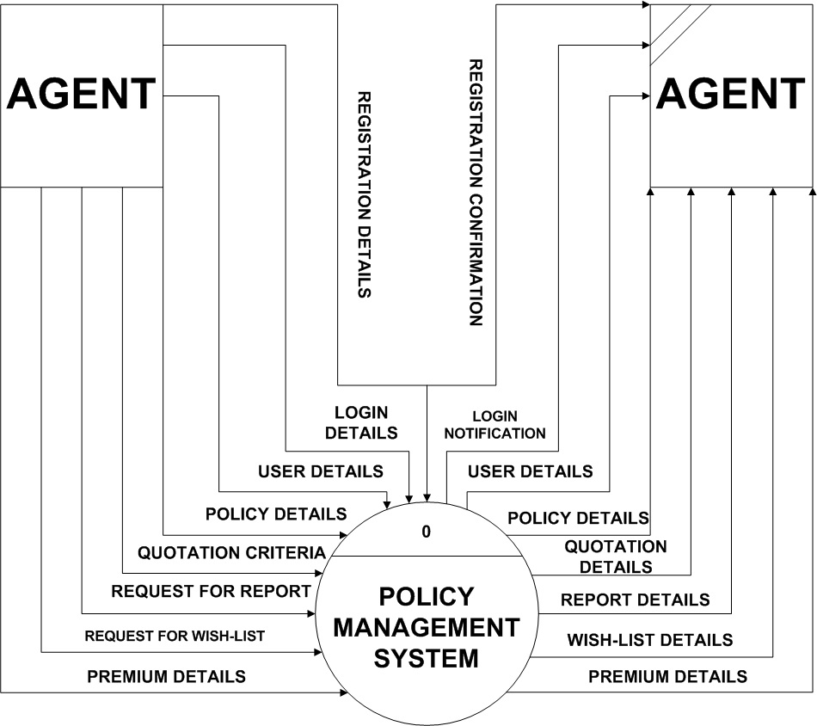
Context Level

Slide 23
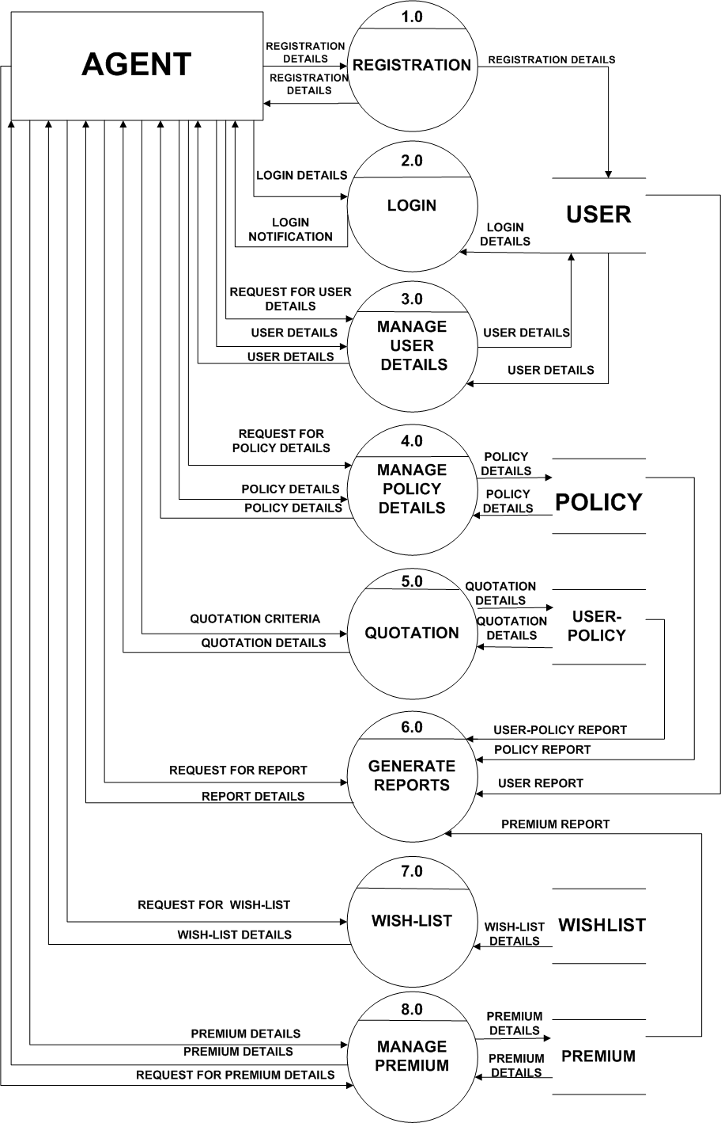
First Level

Slide 24
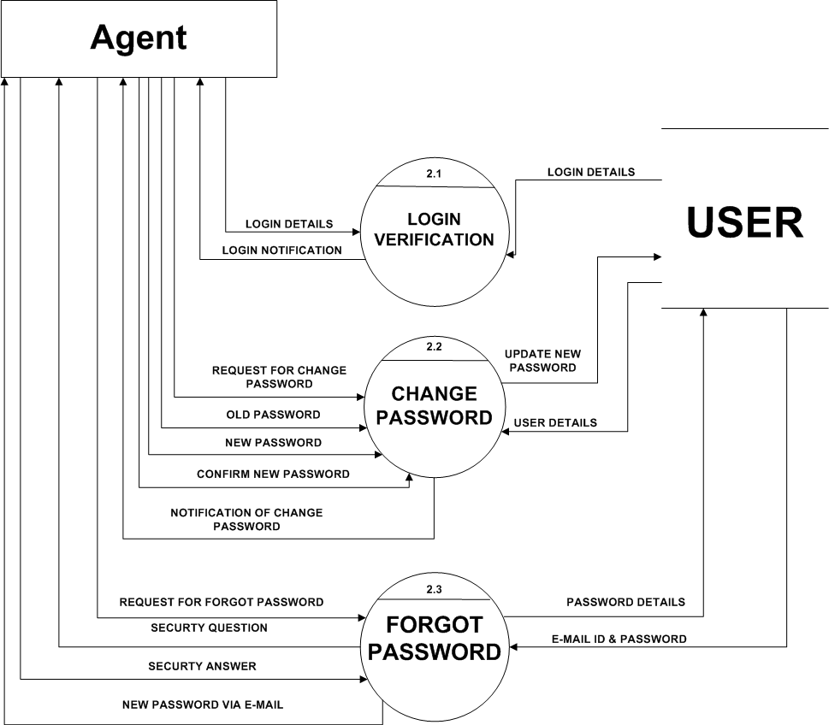
Second Level Process - 2

Slide 25
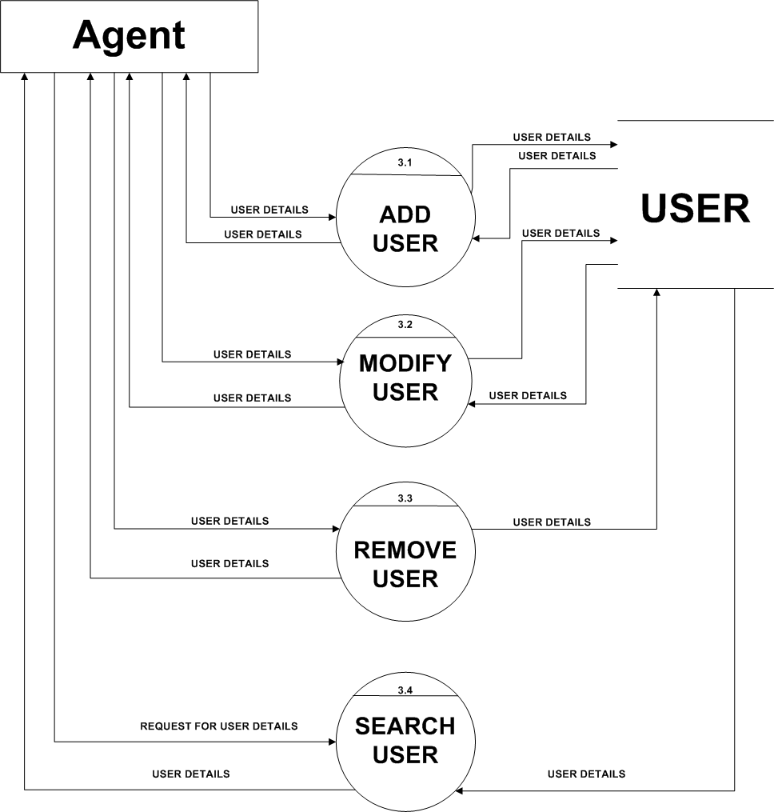
Second Level Process - 3

Slide 26
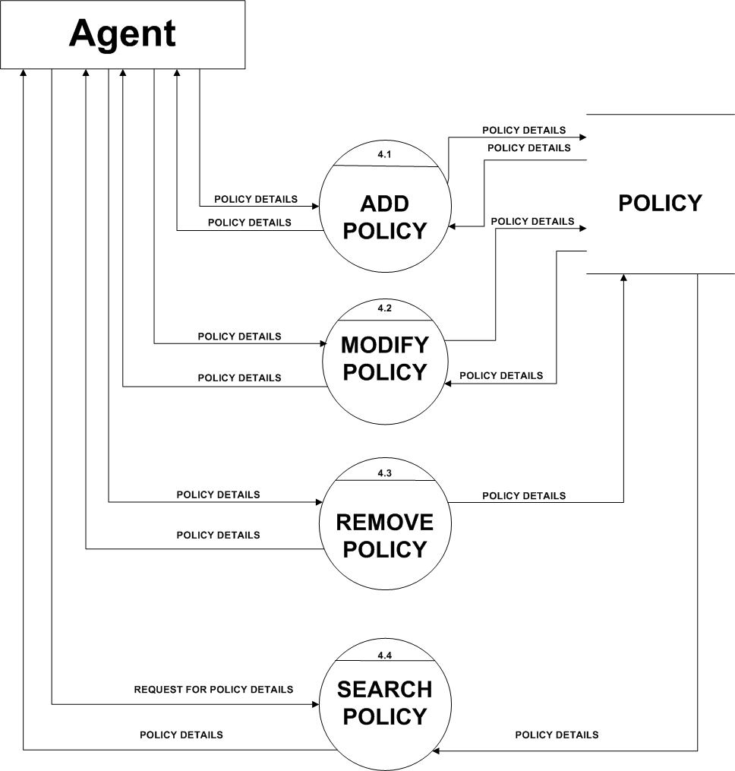
Second Level Process - 4

Slide 27
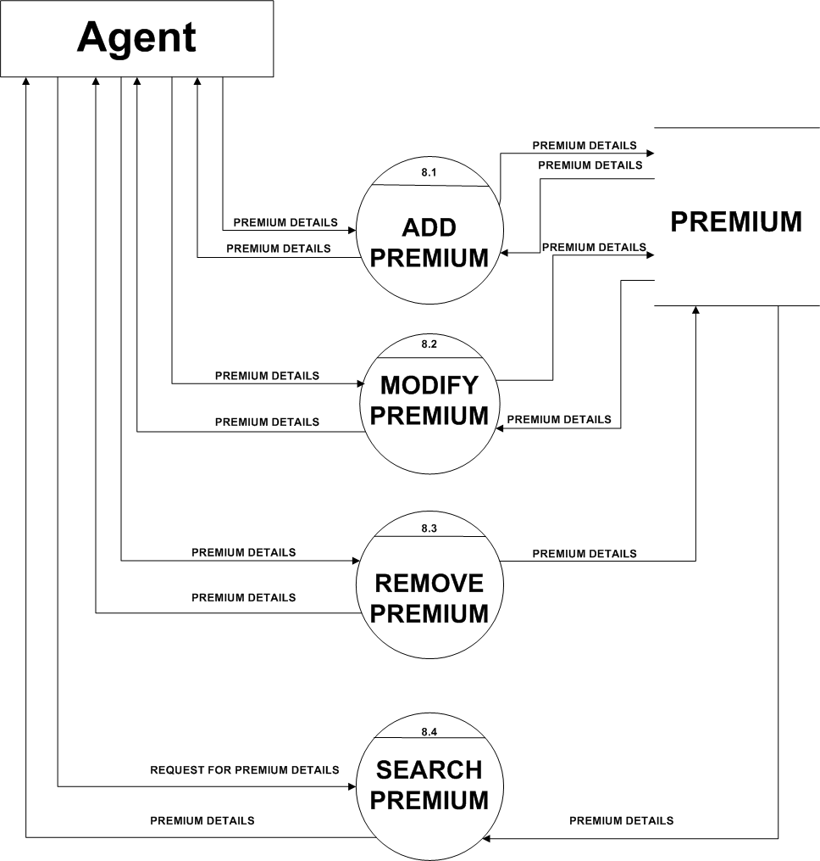
Second Level Process - 8

Slide 28
UML DIAGRAMS

Slide 29
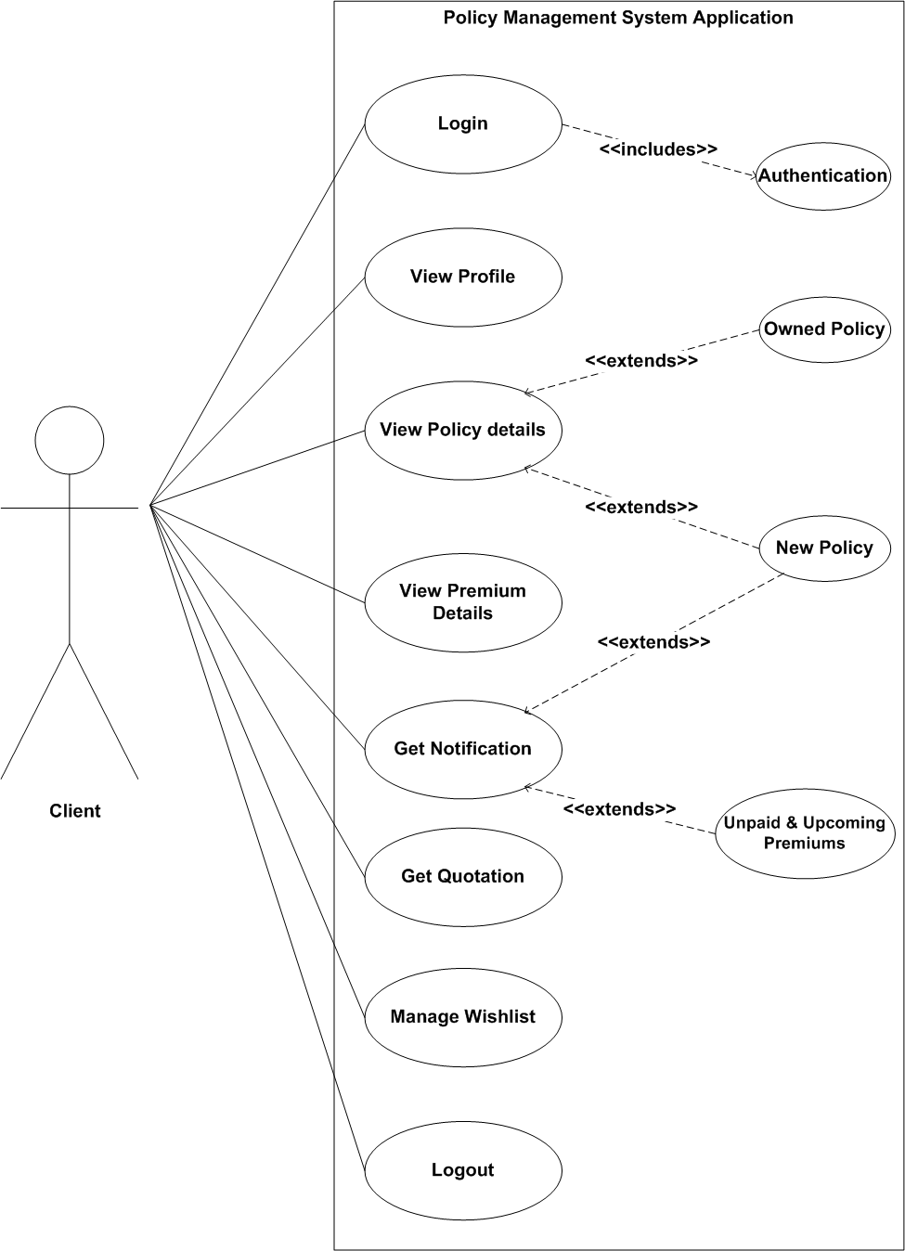
USE-CASE DIAGRAM

Slide 30
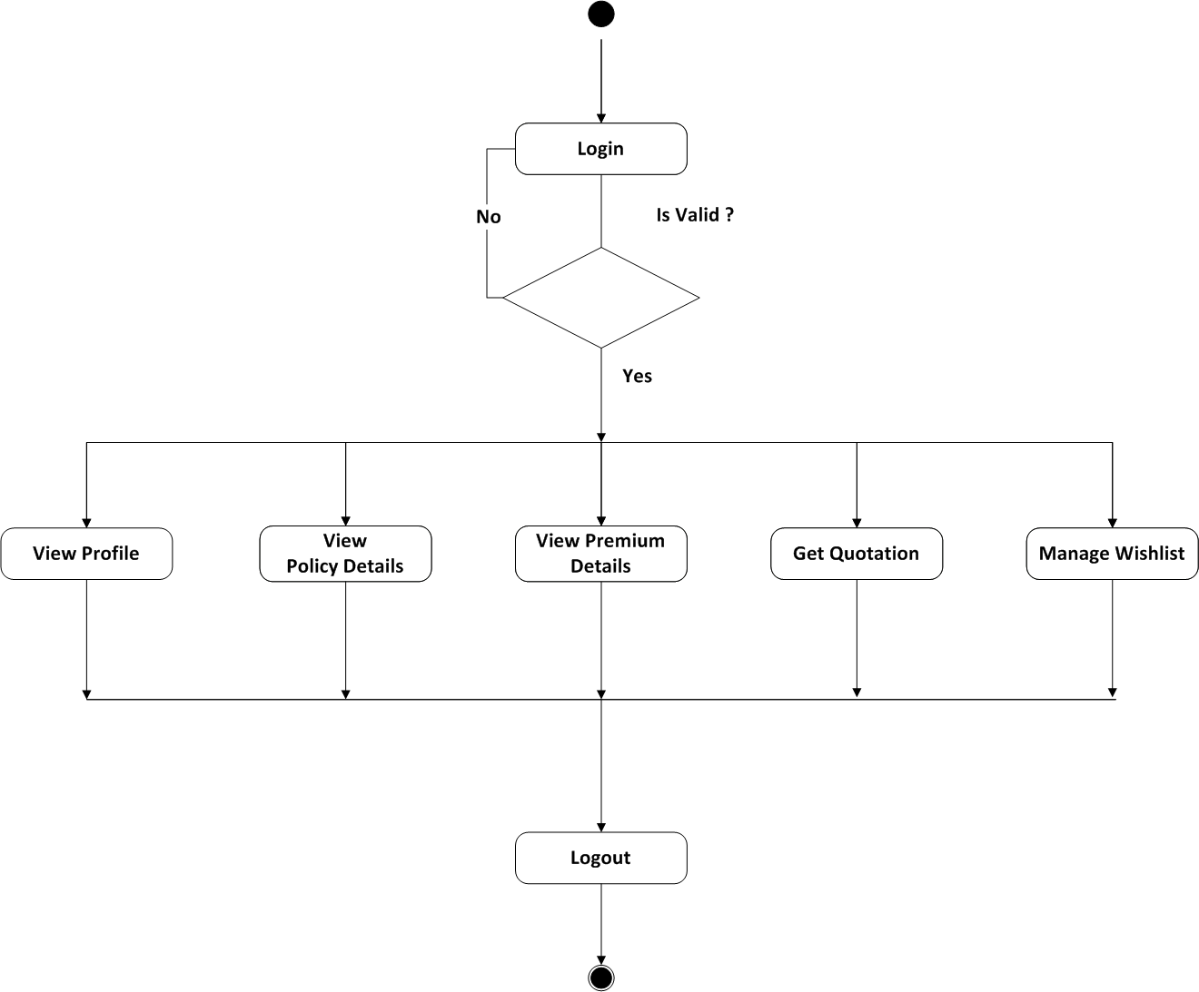
ACTIVITY DIAGRAM

Slide 31
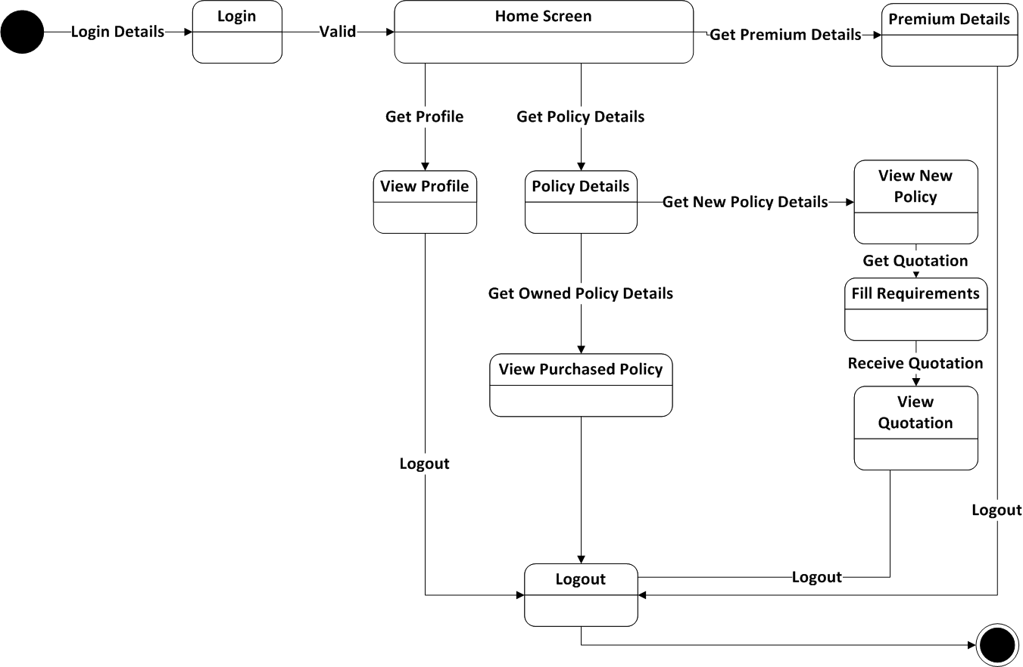
STATE-CHART DIAGRAM

Slide 32
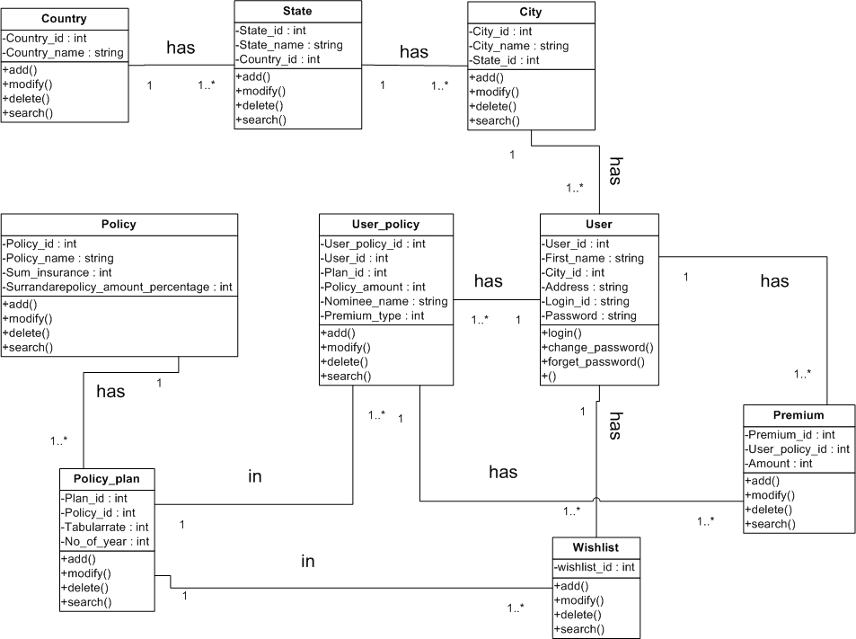
CLASS DIAGRAM

Slide 33
SEQUENCE DIAGRAM

Slide 34
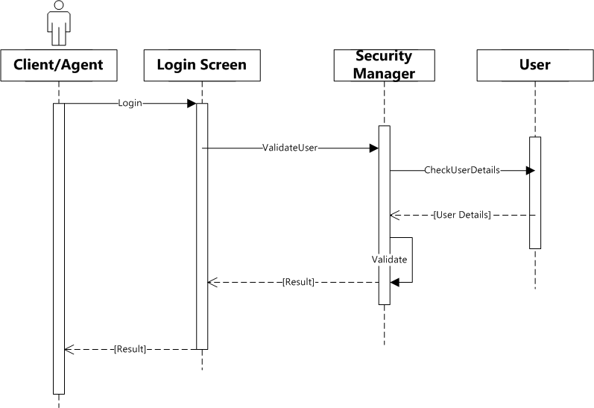
LOGIN

Slide 35
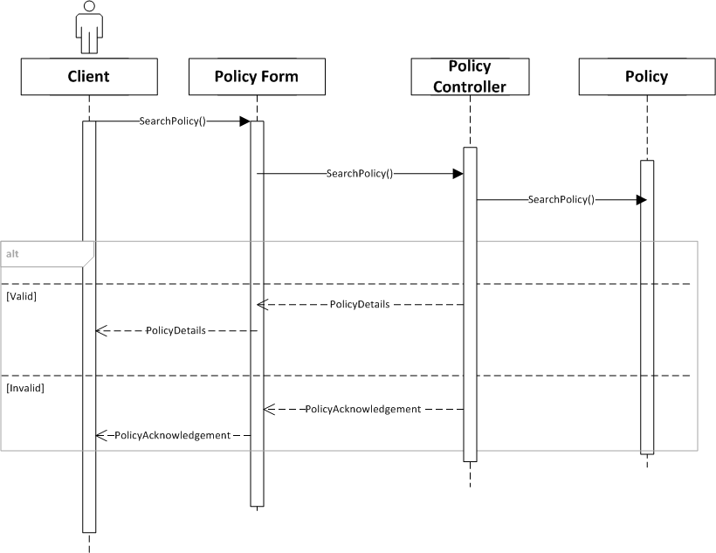
POLICY

Slide 36
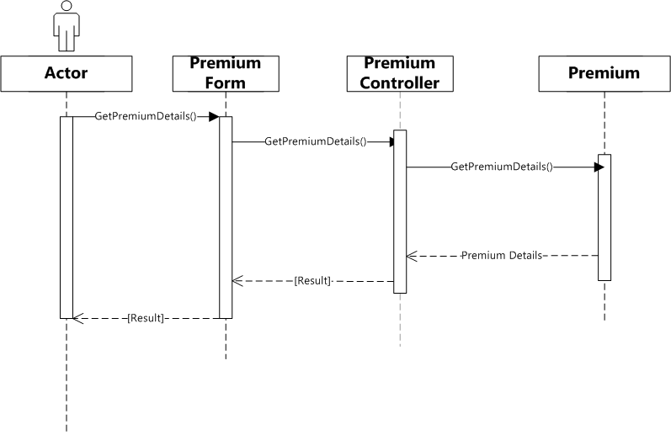
PREMIUM

Slide 37
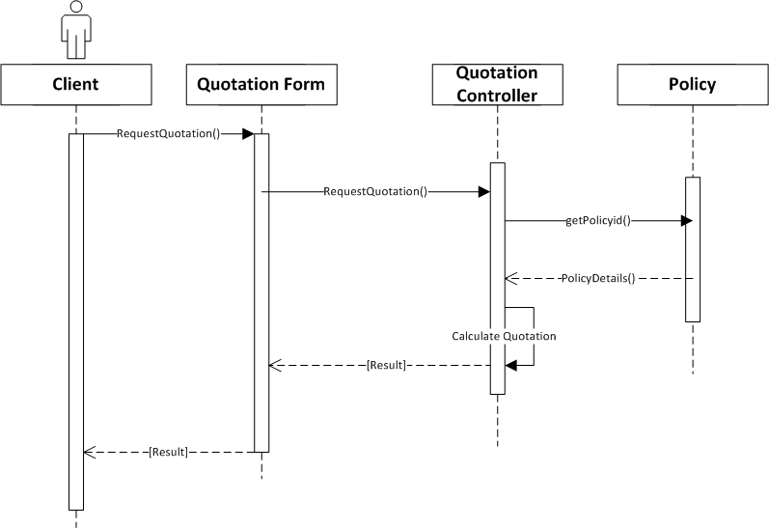
QUOTATION

Slide 38
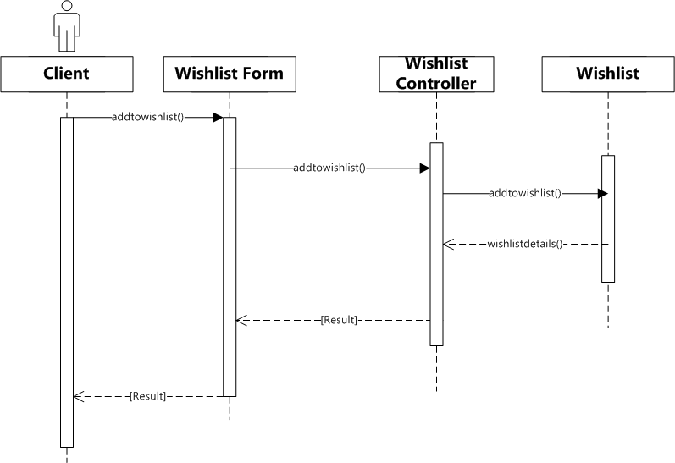
WISHLIST

Slide 39
Data-Dictionary

Slide 40
TABLE NAME : COUNTRY TABLE TABLE DESCRIPTION : STORES COUNTRY NAMES AND ASSIGN UNIQUE ID TO EACH COUNTRY.
FIELD_NAME | DATA TYPE | SIZE | CONSTRAINTS | DESCRIPTION
Country_id | TINYINT | 3 | PRIMARY KEY | IT WILL ASSIGN UNIQUE ID TO EACH COUNTRY AND STORE AS COUNTRY_ID.
Country_name | VARCHAR | 50 | NOT NULL | IT WILL STORE THE COUNTRY NAME.

Slide 41
TABLE NAME : STATE TABLE
TABLE DESCRIPTION : STORES STATE NAMES AND ASSIGNS UNIQUE ID TO EACH STATE.
FIELD_NAME | DATA TYPE | SIZE | CONSTRAINTS | DESCRIPTION
State_id | TINYINT | 3 | PRIMARY KEY | IT WILL ASSIGN UNIQUE ID TO EACH STATE AND STORE AS STATE_ID.
State_name | VARCHAR | 50 | NOT NULL | IT WILL STORE THE STATE NAMES.
Country_id | TINYINT | 3 | FOREIGN KEY | IT IS THE PRIMARY KEY OF COUNTRY TABLE. IT IS THE FOREIGN KEY IN THIS TABLE AND CREATES A LINK BETWEEN COUNTRY TABLE AND STATE TABLE.

Slide 42
TABLE NAME : CITY TABLE
TABLE DESCRIPTION : STORES CITY NAMES AND ASSIGN UNIQUE ID TO EACH CITY.
FIELD_NAME | DATA TYPE | SIZE | CONSTRAINTS | DESCRIPTION
City_id | TINYINT | 3 | PRIMARY KEY | IT WILL ASSIGN UNIQUE ID TO EACH CITY AND STORE AS CITY_ID.
City_name | VARCHAR | 50 | NOT NULL | IT WILL STORE THE CITY NAMES.
State_id | TINYINT | 3 | FOREIGN KEY | IT IS THE PRIMARY KEY OF STATE TABLE. IT IS THE FOREIGN KEY IN THIS TABLE AND CREATES A LINK BETWEEN STATE TABLE AND CITY TABLE.

Slide 43
TABLE NAME : USER TABLE
TABLE DESCRIPTION : STORES ALL THE REQUIRED DETAILS OF EACH CLIENT.
FIELD_NAME | DATA TYPE | SIZE | CONSTRAINTS | DESCRIPTION
User_id | INT | 10 | PRIMARY KEY | IT WILL ASSIGN UNIQUE ID TO EACH USER AND STORE AS USER_ID.
First_name | VARCHAR | 50 | NOT NULL | IT WILL STORE THE FIRST NAME OF EACH USER.
Middle_name | VARCHAR | 50 | NOT NULL | IT WILL STORE MIDDLE NAME OF EACH USER.
Last_name | VARCHAR | 50 | NOT NULL | IT WILL STORE THE LAST NAME OF EACH USER.
Address | VARCHAR | 255 | NOT NULL | IT WILL STORE THE ADDRESS OF EACH USER.
City_id | TINYINT | 3 | FOREIGN KEY | IT IS A PRIMARY KEY OF CITY TABLE.IT WILL CREATE A LINK BETWEEN USER TABLE AND CITY TABLE.IT WILL BECOME THE CHILD TABLE OF USER TABLE.

Slide 44
USER TABLE(Continue)
FIELD_NAME | DATA TYPE | SIZE | CONSTRAINTS | DESCRIPTION
Phone_number | INT | 13 | NOT NULL | IT WILL STORE THE PHONE NUMBER OF EACH USER.
E-mail_id | VARCHAR | 30 |  | IT WILL STORE THE EMAIL_ID OF EACH USER.IT I S OPTIONAL.
Date_of_birth | DATE |  | NOT NULL | IT WILL STORE THE BIRTHDATE OF THE USER.
Photo | VARCHAR | 100 | NOT NULL | IT WILL STORE THE PHOTO OF EACH USER AS AN IDENTITY OF USER.
MaritaL_status | TINYINT | 1 | NOT NULL | IT WILL STORE THE MARITAL INFORMATION OF USER. 1 IF USER IS MARRIED AND 0 IF USER IS NOT MARRIED
Gender | TINYINT | 1 | NOT NULL | IT WILL STORE THE GENDER OF THE USER. IT HAS THREE OPTIONS 0 -MALE, 1 - FEMALE AND 2 - OTHERS.

Slide 45
USER TABLE(Continue)
FIELD_NAME | DATA TYPE | SIZE | CONSTRAINTS | DESCRIPTION
Login_id | VARCHAR | 30 | NOT NULL | IT WILL STORE THE LOGIN_ID OF EACH USER.
Password | VARCHAR | 20 | NOT NULL | IT WILL STORE THE PASSWORD OF EACH USER.
Anniversary_date | DATE |  |  | IT WILL STORE THE ANNIVERSARY DATE OF USER IF THE USER IS MARRIED.THUS,IT IS OPTIONAL.
Id_proof | VARCHAR | 100 | NOT NULL | IT WILL STORE IMAGE FILE OF EITHER OF THE GOVERNMENT GENERATED ID PROOFS FOR EG : DRIVING LICENCE , PASSPORT , ELECTION CARD , AADHAR CARD , PAN CARD.
Address_proof | VARCHAR | 100 | NOT NULL | IT WILL STORE IMAGE FILE OF EITHER OF THE ADDRESS PROOFS FOR EG : ELECTRICITY BILL , TELEPHONE BILL , WATER BILL.
Office_address | VARCHAR | 255 |  | IT WILL STORE THE OFFICE ADDRESS OF EACH USER. IT IS OPTIONAL.

Slide 46
USER TABLE(Continue)
FIELD_NAME | DATA TYPE | SIZE | CONSTRAINTS | DESCRIPTION
User_type | TINYINT | 1 | NOT NULL | IT STORES IF THE USER IS A CLIENT OR AN ADMIN . 0 – CLIENT 1 - ADMIN
Premium_payment_mode | TINYINT | 1 | NOT NULL | IT STORES IF THE CLIENT WILL PAY MONEY ONLINE OR TO THE AGENT 0 – ONLINE 1 - MANUAL
Registration_date | DATE |  | NOT NULL | IT WILL STORE THE REGISTRATION DATE OF EACH USER.

Slide 47
TABLE NAME : POLICY TABLE
TABLE DESCRIPTION : STORES DETAILS OF EACH POLICY.
FIELD_NAME | DATA TYPE | SIZE | CONSTRAINTS | DESCRIPTION
Policy_id | INT | 5 | PRIMARY KEY | IT WILL ASSIGN AN UNIQUE ID TO EACH POLICY.
Policy_name | VARCHAR | 50 | NOT NULL | IT WILL STORE THE NAMES OF EACH POLICY.
Policy_number | VARCHAR | 10 | NOT NULL | IT WILL STORE THE POLICY NUMBER OF EACH POLICY.
Sum_insurance | INT | 8 | NOT NULL | IT STORES THE MINIMUM AMOUNT OF THE POLICY .
Surrandarepolicy_amount_percentage | TINYINT | 3 | NOT NULL | IT STORES THE PERCENTAGE AMOUNT A USER CAN GET WHEN HE DISCONTINUES HIS/HER POLICY..
Min_age | TINYINT | 2 | NOT NULL | IT WILL STORE THE MINIMUM AGE REQUIRED FOR THIS POLICY.
Max_age | TINYINT | 2 | NOT NULL | IT WILL STORE THE MAXIMUM AGE REQUIRED FOR THIS POLICY.

Slide 48
TABLE NAME : POLICY_PLAN TABLE
TABLE DESCRIPTION: STORES PLANS OF EACH POLICY.
FIELD_NAME | DATA TYPE | SIZE | CONSTRAINTS | DESCRIPTION
Plan_id | TINYINT | 2 | PRIMARY KEY | IT WILL STORE THE PLAN ID OF EACH POLICY PLAN.
Policy_id | INT | 5 | FOREIGN KEY | IT IS A PRIMARY KEY OF POLICY TABLE.IT WILL CREATE A LINK BETWEEN POLICY TABLE AND POLICY_PLAN TABLE.
Tabularrate | TINYINT | 3 | NOT NULL | IT IS A RATE DEFINED BY THE POLICY MAKERS FOR CALCULATING THE PREMIUM.
S_A_Rebet_two_to_five_lac | TINYINT | 2 | NOT NULL | IT STORES A DISCOUNT VALUE A USER CAN GET WHEN HIS POLICY IS BETWEEN 2 TO 5 LAKHS.THIS DISCOUNT IS GIVEN ON TABULARRATE.
S_A_Rebet_above_five_lac | TINYINT | 2 | NOT NULL | IT STORES A DISCOUNT VALUE A USER CAN GET WHEN HIS POLICY IS ABOVE 5 LAKHS. THIS DISCOUNT IS GIVEN ON TABULARRATE.
Mode_Rebet_sixmonth_premium | TINYINT | 2 | NOT NULL | IT STORES A DISCOUNT VALUE A USER CAN GET WHEN HE PAYS PREMIUM EVERY HALF YEARLY.THIS DISCOUNT IS GIVEN ON TABULARRATE.
Mode_Rebet_oneyear_premium | TINYINT | 2 | NOT NULL | IT STORES A DISCOUNT VALUE A USER CAN GET WHEN HE PAYS PREMIUM EVERY YEARLY THIS DISCOUNT IS GIVEN ON TABULARRATE.
No_of_year | TINYINT | 2 | NOT NULL | IT STORES THE NUMBER OF YEARS FOR THE POLICY.

Slide 49
TABLE NAME : USER_POLICY_TABLE
TABLE DESCRIPTION : STORES THE DETAILS OF USER WHO PURCHASED A POLICY.
FIELD_NAME | DATA TYPE | SIZE | CONSTRAINTS | DESCRIPTION
User_policy_id | TINYINT | 2 | PRIMARY KEY | ASSIGN UNIQUE ID TO EACH POLICY PURCHASED BY THE USER
User_id | INT | 10 | FOREIGN KEY | IT IS A PRIMARY KEY OF USER TABLE.IT WILL CREATE A LINK BETWEEN CLIENT_POLICY TABLE AND USER TABLE.
Plan_id | TINYINT | 2 | FOREIGN KEY | IT IS A PRIMARY KEY OF POLICY_PLAN TABLE.IT WILL CREATE A LINK BETWEEN PLOICY_PLAN TABLE AND CLIENT_POLICY TABLE.
Policy_purchase_date | DATE |  | NOT NULL | IT WILL STORE THE DATE OF WHEN THE POLICY WAS PURCHASED.
Policy_amount | INT | 10 | NOT NULL | IT WILL STORE THE TOTAL AMOUNT OF THE POLICY.
Nominee_name | VARCHAR | 100 | NOT NULL | IT WILL STORE THE NOMINEE NAME GIVEN BY THE USER.
Relation_type | VARCHAR | 30 | NOT NULL | STORE THE KIND OF RELATION BETWEEN THE NOMINEE AND THE USER.

Slide 50
USER_POLICY_TABLE (Continue)
FIELD_NAME | DATA TYPE | SIZE | CONSTRAINTS | DESCRIPTION
Premium_type | TINYINT | 1 | NOT NULL | STORE THE TYPE IN WHICH THE PREMIUM IS PAID TO THE AGENT. 0 – YEARLY,1 – HALF_YEARLY,2 – 3 MONTHLY,3 – MONTHLY
Policy_status | TINYINT | 1 | NOT NULL | STORES THE STATUS OF THE POLICY. 0 – LAPSED 1 – IT STILL EXISTS

Slide 51
TABLE NAME : PREMIUM TABLE
TABLE DESCRIPTION : STORES ALL THE DETAILS RELATED TO PREMIUM
FIELD_NAME | DATA TYPE | SIZE | CONSTRAINTS | DESCRIPTION
Premium_id | TINYINT | 2 | PRIMARY KEY | ASSIGN UNIQUE ID TO EACH PREMIUM.
User_policy_id | TINYINT | 2 | FOREIGN KEY | IT IS A PRIMARY KEY OF USER_POLICY TABLE .IT IS A CHILD TABLE OF PREMIUM TABLE. IT CREATES A LINK BETWEEN PREMIUM TABLE AND CLIENT_POLICY TABLE.
Payment_date | DATE |  | NOT NULL | IT WILL STORE THE DATE ON WHICH PREMIUM WAS PAID BY THE CLIENT.
Amount | INT | 8 | NOT NULL | STORES THE AMOUNT THAT IS TO BE PAID BY THE CLIENT.
Check_Number | VARCHAR | 14 |  | STORES THE CHECK NUMBER IF THE PREMIUM PAYMENT IS DONE BY CHEQUE.
Payment_mode | TINYINT | 1 | NOT NULL | STORES THE TYPE OF MODE THROUGH WHICH THE CLIENT DOES THE PAYMENT. 0 – CASH 1 – CHEQUE.

Slide 52
TABLE NAME: TAX TABLE
TABLE DESCRIPTION: IT STORES INFORMATION ABOUT HOW MUCH PERCENTAGE SHOULD BE USED IN CALCULATION OF DIFFERENT TAXES.
FIELD_NAME | DATA TYPE | SIZE | CONSTRAINTS | DESCRIPTION
Tax_id | TINYINT | 2 | PRIMARY KEY | IT WILL ASSIGN UNIQUE ID TO DIFFERENT TYPES OF TAX.
Tax_name | VARCHAR | 50 | NOT NULL | IT WILL STORE THE TAX NAMES.
Tax_percentage | TINYINT | 2 | NOT NULL | IT WILL STORE THE PERCENTAGE VALUE OF EACH TAX, USED IN EVALUATION OF PREMIUM.

Slide 53
TABLE NAME : BANK TABLE
TABLE DESCRIPTION : CONTAINS DETAILS OF BANKS INVOLVED AND ACCOUNT NUMBERS.
FIELD_NAME | DATA TYPE | SIZE | CONSTRAINTS | DESCRIPTION
Bank_id | TINYINT | 2 | PRIMARY KEY | IT WILL ASSIGN UNIQUE ID TO EACH BANK.
Bank_name | VARCHAR | 20 | NOT NULL | IT WILL STORE BANK NAMES.
Account_no | VARCHAR | 20 | NOT NULL,UNIQUE | IT WILL STORE ACCOUNT NUMBER OF EACH USER.

Slide 54
TABLE NAME: WISHLIST TABLE
TABLE DESCRIPTION:STORES THE WISHLIST OF USERS.
(STORES IN WHATPOLICIES INDIVIDUAL USER IS INTERESTED).
FIELD_NAME | DATA TYPE | SIZE | CONSTRAINTS | DESCRIPTION
Wishlist_id | TINYINT | 3 | PRIMARY KEY | IT WILL ASSIGN UNIQUE ID TO EACH WISHLIST AND STORE AS WISHLIST_ID.
User_id | INT | 10 | FOREIGN KEY | IT IS A PRIMARY KEY OF USER TABLE.IT WILL CREATE A LINK BETWEEN WISHLIST TABLE AND USER TABLE.
Plan_id | TINYINT | 2 | FOREIGN KEY | IT IS THE PRIMARY KEY OF POLICY_PLAN TABLE. IT IS THE FOREIGN KEY IN THIS TABLE AND CREATES A LINK BETWEEN POLICY_PLAN TABLE AND USER_WISHLIST TABLE

Slide 55
ANY QUESTIONS ?

Slide 56
THANK YOU

